Slide 1
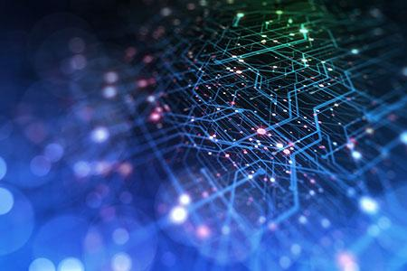
TPC Hackathon Day 2
Notes:
Thanks for the introduction
Thanks to the organizers for the invitation to give a keynote
Of course, I would like also to thank all the collaborators and students, postdocs and researchers who collaborated with me.
Don’t count, there are more than 450 ;-)
You know it already; it is extremely hard to succeed alone in research. So, I took the easy way: I collaborated with many talented researchers.
I would like to thank all of them for sharing some of their time and for all the discussions we had.

Slide 2
Morning Agenda
08:00-08:30 [Lower Gallery] Coffee and Breakfast Snacks
08:30-09:00 Plenary [https://argonne.zoomgov.com/j/1609752901] passcode: 871601
Update from day 1.
09:00-09:30 Plenary [https://argonne.zoomgov.com/j/1609752901] passcode: 871601 Salman Habib (15 + 15)
09:30-10:45 [Lower Gallery] Session 3 (Eval+data) (chairs: Sandeep, Robert, Franck)
Zoom: https://argonne.zoomgov.com/j/1608562033
DataSources/Eval – Narratives
Speaker: Clark Cucinell (ANL), Azton Wells (ANL)
Datasets+Eval for multi-modal data (e.g. use cases and metrics)
Model/Data adaptations for Multi-modal (tokenizer, semantic, data reduction for training, etc.)
Do we need and if so how to use a small set of tokenizers for training and inferences? Speaker: Neil Getty, Tanwi Mallick (ANL)
Datasets for training this tokenizer - images, graphs, and beyond…
Floating point tokenization in HEP: Azton Wells (ANL)
10:45-11:00 Break
11:00-12:30 [Lower Gallery] Session 4 (Eval+data)
Zoom: https://argonne.zoomgov.com/j/1608562033
Multi-modal RAG
Arvind Ramanathan (ANL)
Robert Underwood (ANL)
Multi-modal Contamination/Dedup
Robert Underwood, Yadu, Arham
12:30-14:00 [Lower Gallery] Lunch

Slide 3
Data Session 1&2 Report
About 16 participants
Notes:
Thanks for the introduction
Thanks to the organizers for the invitation to give a keynote
Of course, I would like also to thank all the collaborators and students, postdocs and researchers who collaborated with me.
Don’t count, there are more than 450 ;-)
You know it already; it is extremely hard to succeed alone in research. So, I took the easy way: I collaborated with many talented researchers.
I would like to thank all of them for sharing some of their time and for all the discussions we had.

Slide 4
Data Day 1: Highlights
Presentations:
Robert – State of Data at ANL
Brad – Negotiations for Datasets and Legal
Jorge shared experiences from BSC and Europe
Carlo – AdaParse: Accuracy Aware Parsing
Discussions:
Tom – Narratives for Unstructured Grids and Particles using Feature Detection
Tanjin – Scraping Closed Scientific Texts from Academic Publishers
Matthew, Arham – Synthetic Parallel Code and Deduplication for Code
Junchao – PETSc Support Email Lists as a Source of Technical Information

Slide 5
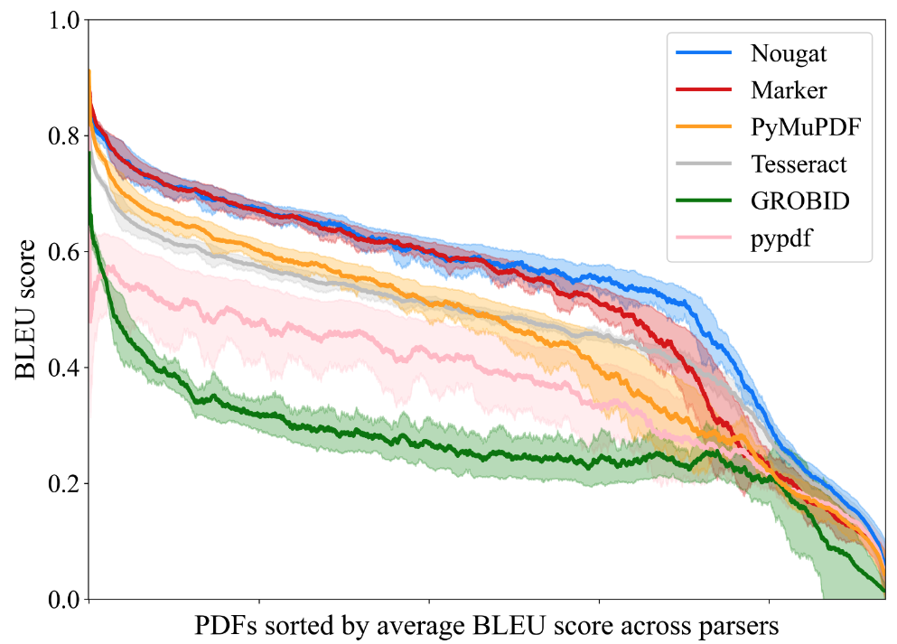
Highlight: AdaParse Accuracy across Parsers
setting 25k PDFs (ArXiv, MedRXiv, MDPI, BioRXiv, Nature, BMC); digital-born
parser performance varies but is correlated (for most PDFs)
performance comes at different cost:
Extraction = fast
OCR/ViTs = slow
PyMuPDF: 50x faster than Nougat

Slide 6
Eval Session 1&2 Report
About 16-18 participants
Notes:
Thanks for the introduction
Thanks to the organizers for the invitation to give a keynote
Of course, I would like also to thank all the collaborators and students, postdocs and researchers who collaborated with me.
Don’t count, there are more than 450 ;-)
You know it already; it is extremely hard to succeed alone in research. So, I took the easy way: I collaborated with many talented researchers.
I would like to thank all of them for sharing some of their time and for all the discussions we had.

Slide 7
10 Talks/Discussion
Presentations
State of the Evaluation
1 ANL (Franck/Sandeep)
2 BSC (Javier)
3 ETH (Maciej)
Evaluation of open responses
4 CheckEmbed - Maciej (ETH)
5 Neil Getty (ANL)
Present Argonne’s Multiple Choice Question (MCQ) initiative and the challenge of generating/validating scientific MCQs at scale. (30 mins.)
6 Analysis of the MCQ benchmark - Murat Keceli (ANL)
7 Coding Benchmark for Science - Eliu Huerta (ANL)
Present Argonne’s Multiple Choice Question (MCQ) initiative and the challenge of generating/validating scientific MCQs at scale. (30 mins.)
8 Automatic generation of benchmarks in Astrophysics - Josh Nguyen (University of Pennsylvania/ANL)
9 Automatic validation of scientific benchmarks Neil Getty (ANL)
Eval in the age of Inference Compute (i.e. how do we measure and compare when there are different numbers of “thinking” tokens like for o1 using the same size model) (15 mins.)
10 Sandeep Madireddy (ANL)

Slide 8
Examples of discussion
Argonne presented/discussed the current eval methodology
BSC multi-lingual model leads Europen-LLM leaderboard (much better than BLOOM)
Developed its own benchmark: paid people to generate/validate MCQs
Use LLM as a judge (Prometeus model) for open response (summarization). However few results on evaluation of LLMs as a judge. Needs more research.
ETH: Checkembed can evaluate the confidence of the LLM system by comparing embeddings of multiple responses for the same question (temperature at 1).
It may be hard to detect hallucination in the response of the model for scientific questions. Can we detect hallucination during the reasoning process (e.g. O1)?
Is high conference means correct? No so checkembed is necessary but not sufficient. We need multiple dimensions.
Neil: MCQ and how we score results:
Separate versus Joint. → Need to use both
Multiple shots: how many shots are needed? Shall it be dynamic (prompt optimization)

Slide 9
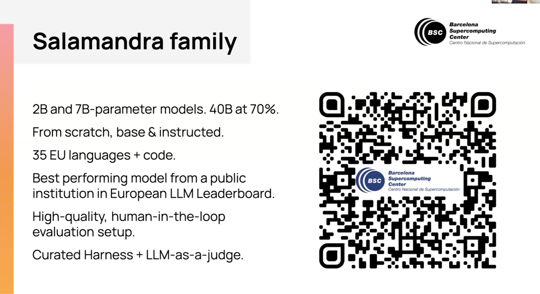
Highlights 1: Salamandra

Slide 10
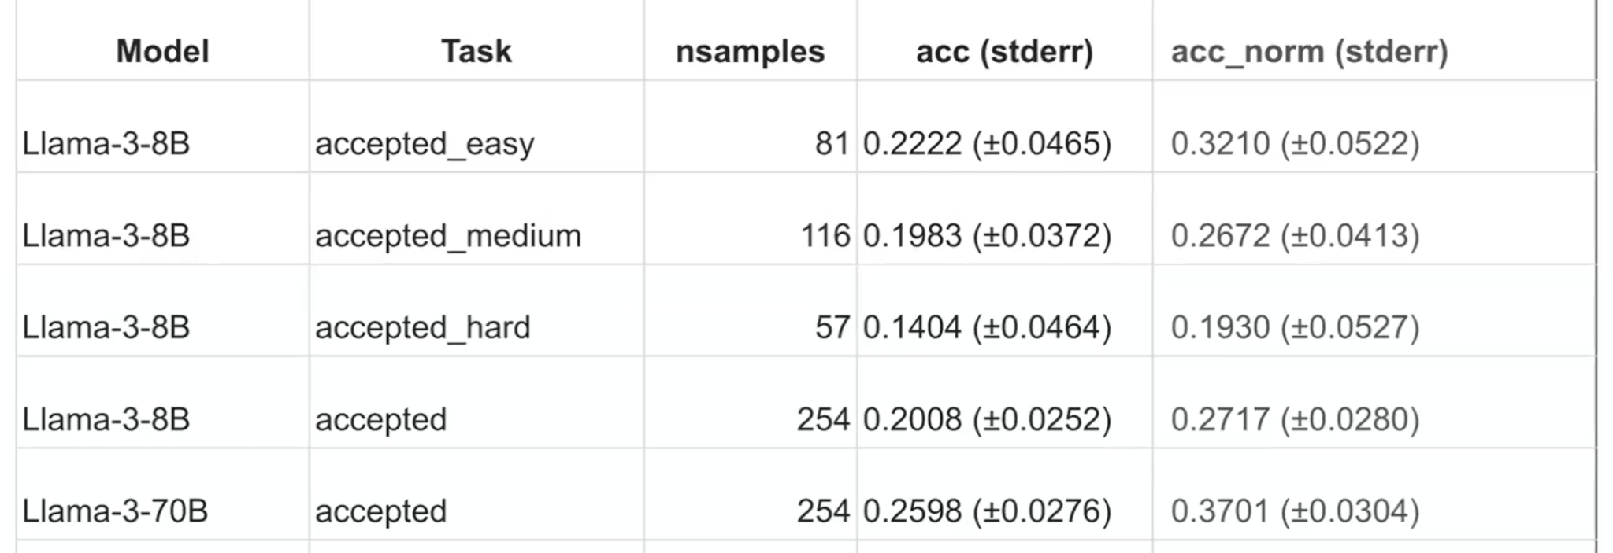
Highlights 2: Argonne AI4S (MCQ Bench Quality)
5 shots
GPQA: 1 correct, 3 distractors. Random choice: 25%
ANL AI4S: 1 correct, 4 distractors. Random choice: 20%

Slide 11
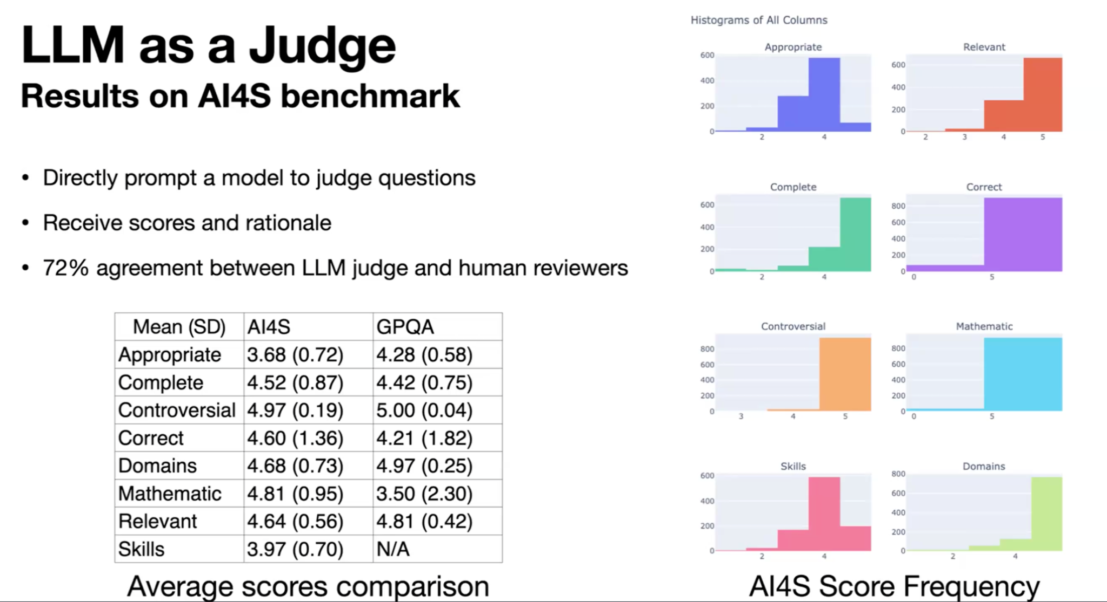
Highlights 3: Argonne Evaluation of MCQs Quality

Slide 12
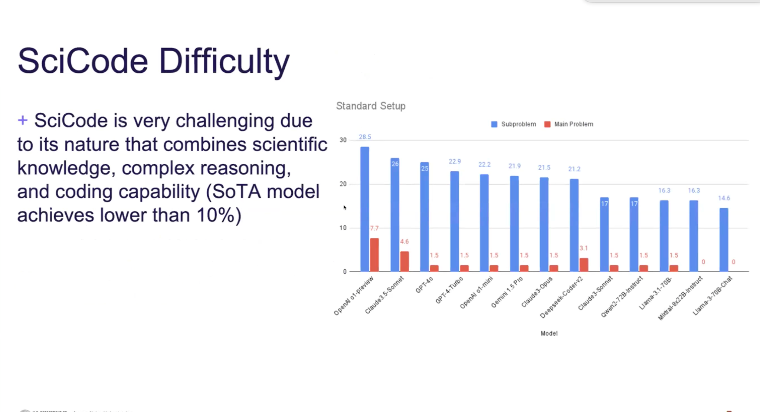
Highlights 4: ANL Scicode
SciCode consists of 80 main problems, decomposed into 338 subproblems. The current SoTA OpenAl 01-preview can only solve 7.7% of main problems.
Example Problem: Ising Model
+ Calculate the total energy given the system Hamiltonian and a system state
+ Sample the distribution of equilibrium states using Metropolis-Hastings
Monte Carlo simulation given a temperature
+ Sweep different temperatures to find the transition temperature.

Slide 13
Identified Collaborations (Skills)
Argonne and BSC: LLM as a judge:
Argonne and ETH:
Use checkembed to check model open response against ground truth (with GPQA).
Improve CE (e.g., take embeddings from other layers?) to make it more robust for certain use cases?
Embedding not only the response but also the question with the answer (to give a context to the response)

Slide 14
Identified Collaborations (Safety)
Bla-Bla

Slide 15
Salman Keynote
Notes:
Thanks for the introduction
Thanks to the organizers for the invitation to give a keynote
Of course, I would like also to thank all the collaborators and students, postdocs and researchers who collaborated with me.
Don’t count, there are more than 450 ;-)
You know it already; it is extremely hard to succeed alone in research. So, I took the easy way: I collaborated with many talented researchers.
I would like to thank all of them for sharing some of their time and for all the discussions we had.

